Slide 1
Terminology tournament
Chapters 5&6

Slide 2
The rules
Arrange yourselves into 4 teams (as even as possible!)
You will have 5 minutes before the tournament starts to look back at your notes and revise the terminology from chapter 5 and 6.
During this time you can create a team cheat sheet
A4 size one sided
Each team will be given a buzzer and a small whiteboard (+marker)
A question will appear on the board, the first team to buzz in with the correct answer wins a point for their team
If you only have a partial answer other teams have the chance to steal your point
If the question requires a written answer or a proof you will need to write the answer on your team’s board BEFORE buzzing in

Slide 3
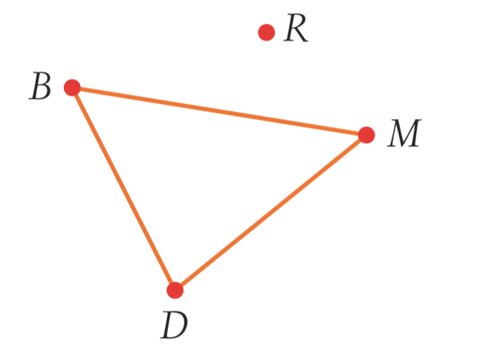
Question 1
Write an adjacency matrix for the following network:
 | B | D | M | R
B | 0 | 1 | 1 | 0
D | 1 | 0 | 1 | 0
M | 1 | 1 | 0 | 0
R | 0 | 0 | 0 | 0

Slide 4
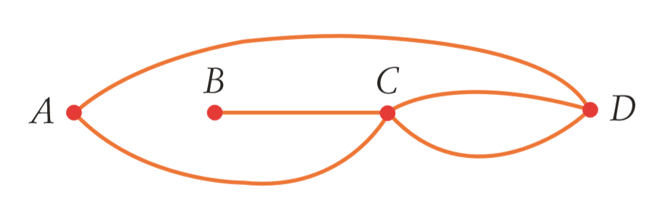
Question 2
Does this network have a bridge?
If so name the bridge
BC

Slide 5
Question 3
What is Euler’s Rule for networks?
V + F = E + 2

Slide 6
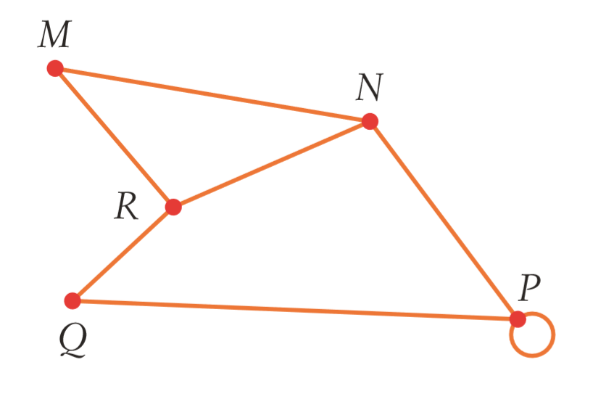
Question 4
Is this network traversable?
Yes!

Slide 7
Question 5
What is a Bipartite network/graph?
A network that contains two groups of nodes/vertices. Nodes from difference groups are connect via edges but nodes within the same group are NOT connected by edges

Slide 8
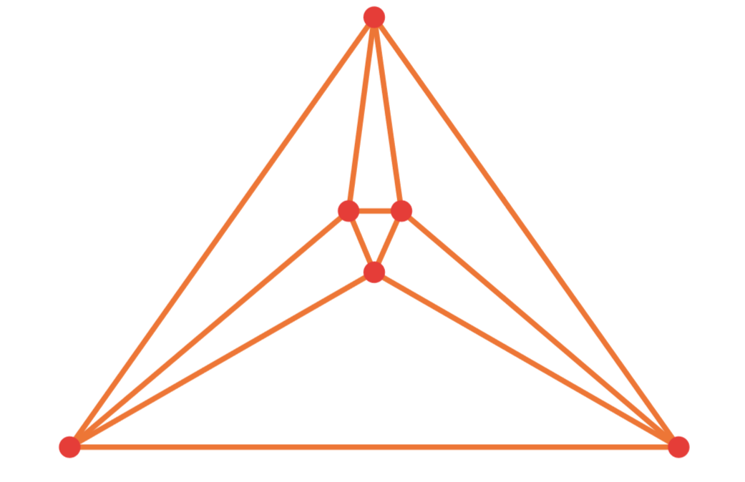
Question 6
What is the length of this network?
12

Slide 9
Question 7
What is the difference between a closed network and an open network?
Closed networks start and finish at the same vertex whereas open networks have different start and finish vertices.

Slide 10
Question 8
What constitutes a simple network?
4 points up for grabs!!
No loops
No multiple edges
Unweighted
Undirected

Slide 11
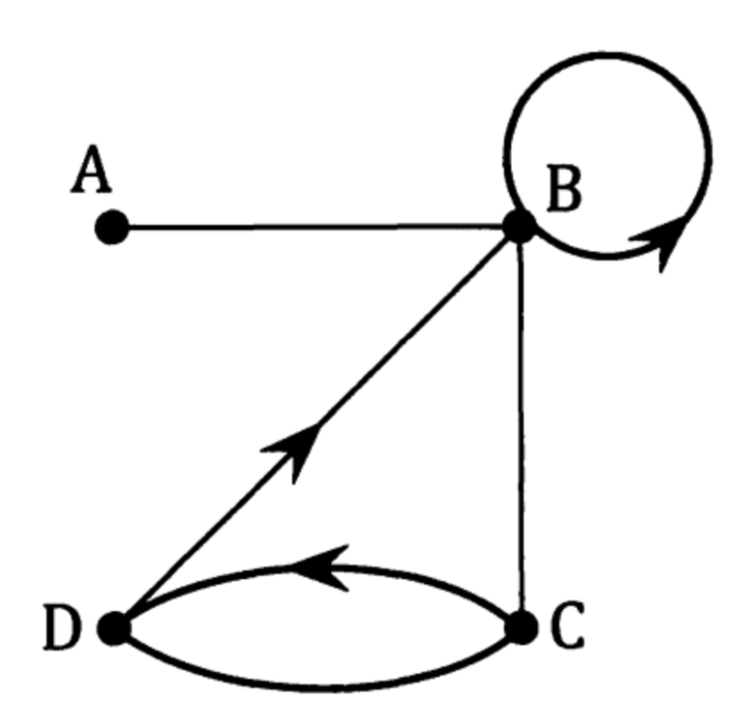
Question 9
Is the network weighted?
No

Slide 12
Question 10
What is a “complete graph”?
A simple graph in which all the vertices are connected to each other by an edge.

Slide 13
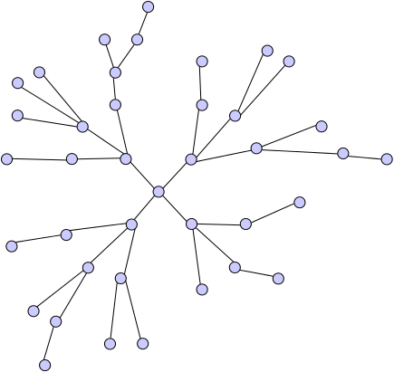
Question 11
What type of network is this?
Tree

Slide 14
Question 12
What is a planar graph?
A graph where no edges cross

Slide 15
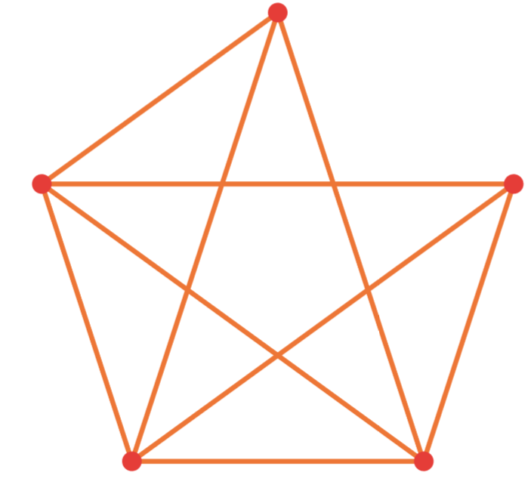
Question 13
Is this network Eulerian, Semi-Eulerian or neither?
Semi-Eulerian

Slide 16
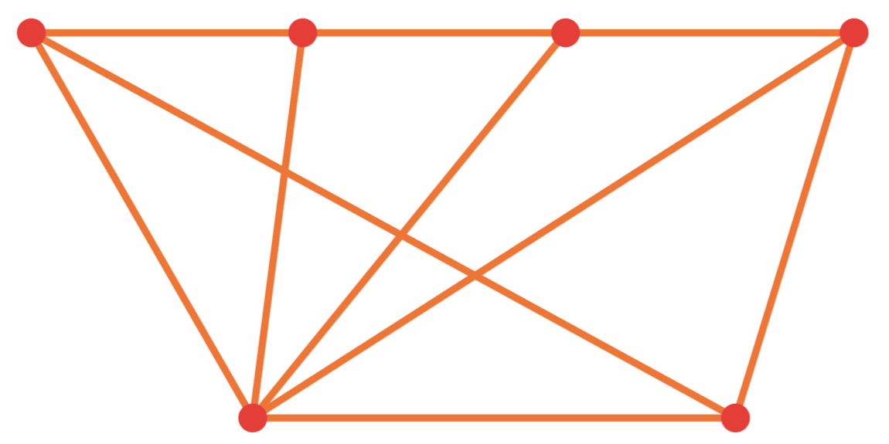
Question 14
Can this network be redrawn as a planar graph?
Yes!

Slide 17
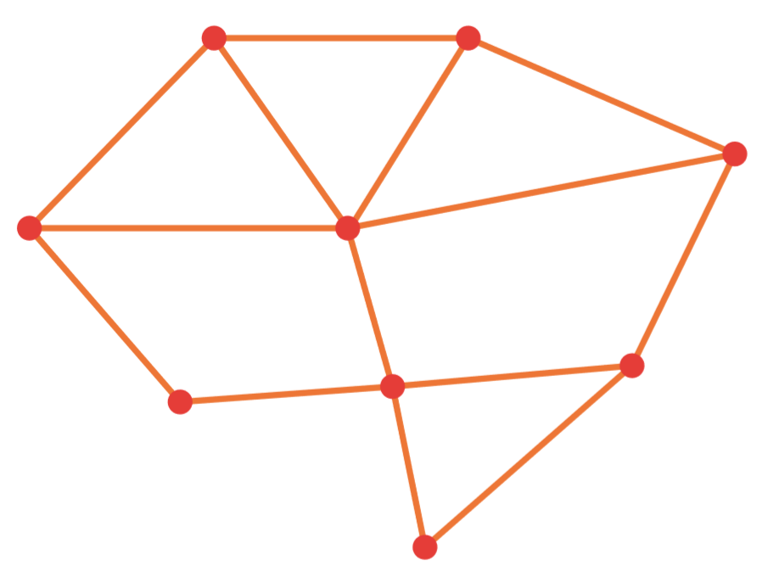
Question 15
Does this graph have a Hamiltonian cycle?
No, it has Hamiltonian paths that are open

Slide 18
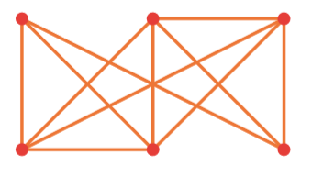
Question 16
Is this graph traversable?
Yes!

Slide 19
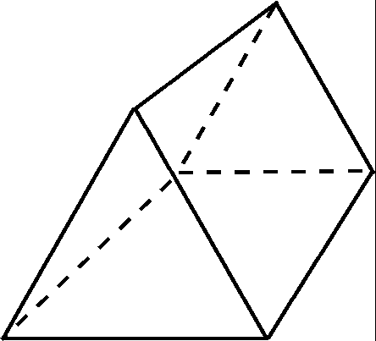
Question 17
Represent this rectangular prism as a planar graph:
9 edges
6 vertices
5 faces

Slide 20
Question 18
Bus route P runs from A to G to F to E and back to A
Bus route Q runs from A to B to G to D to E and back to A
Bus route R runs from B to G to F to C to B
Bus route S runs from B to D to C and back to B
→ Construct a network that conveys these routes

